Slide 1

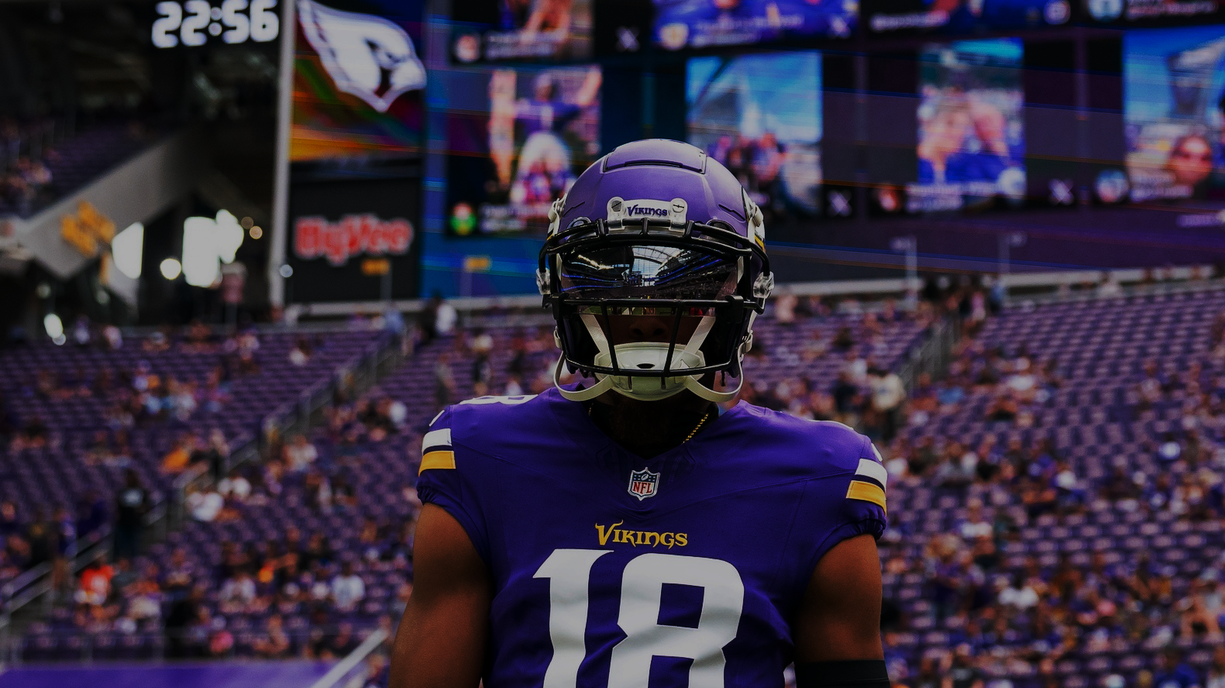
2023 Vikings Offense Analysis
Raven Olson

Slide 2
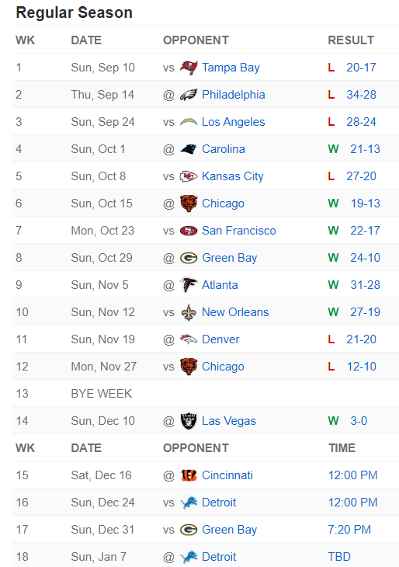
Vikings 2023 Season (so far)
Overall Record: 7-6
Playoff Chances: 62%
According to the New York Times
Updated as of 12/12/2023
Offensive Rankings (through Wk. 14)
Total Offense
Rank: 12th
341.5 yds/game
Total TDs: 30
Passing
Rank: 8th
246.3 pass yds/game
Total Passing TDs: 23
Rushing
Rank: 27th
95.2 rush yds/game
Total Rushing TDs: 5
Cut-off point for data

Slide 3
Questions and Objectives
What are the reasons for the Vikings’ poor rushing attack?
What factors matter the most?
Quarter
Down
Rushing Direction
Formation
Side of the Field

Slide 4
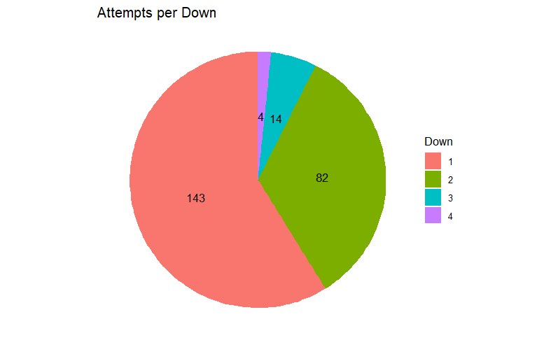
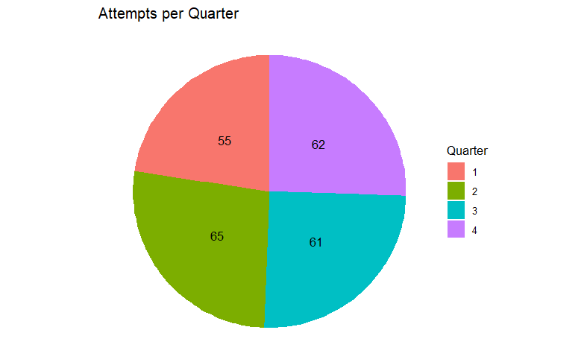
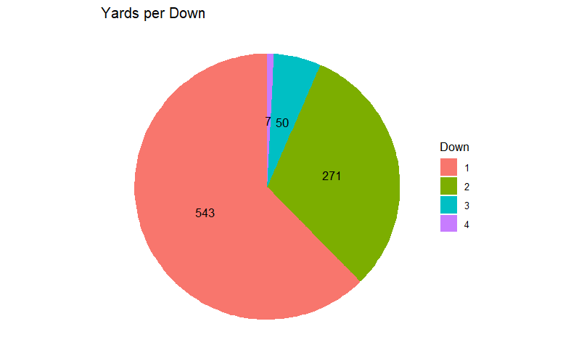
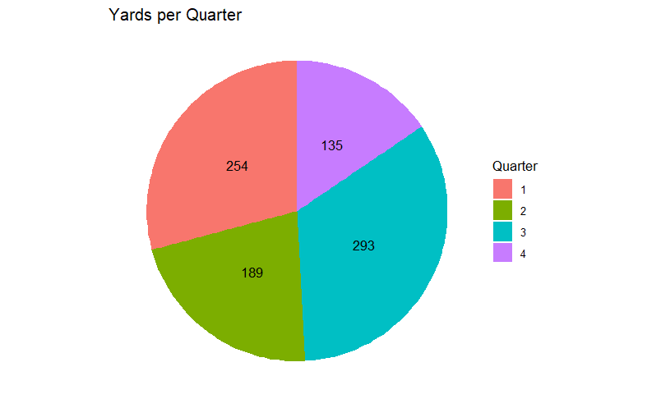
Down
Quarter
Att.
Yds.

Slide 5
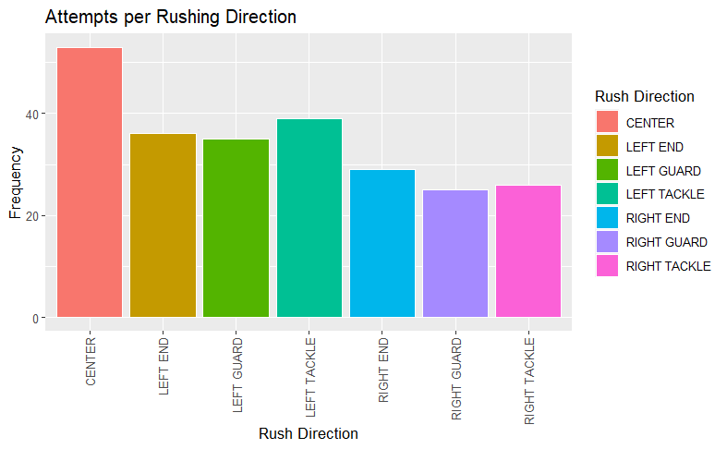
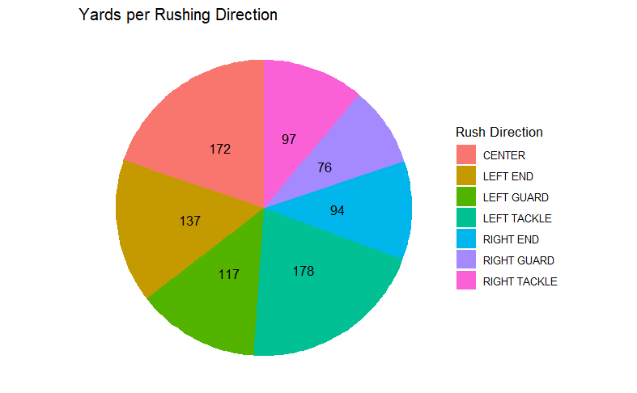
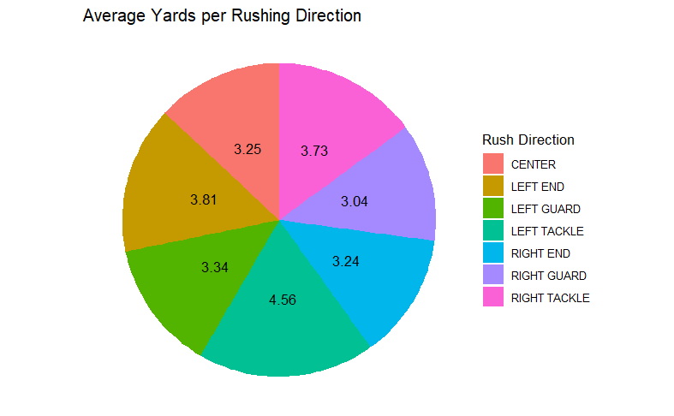

Slide 6
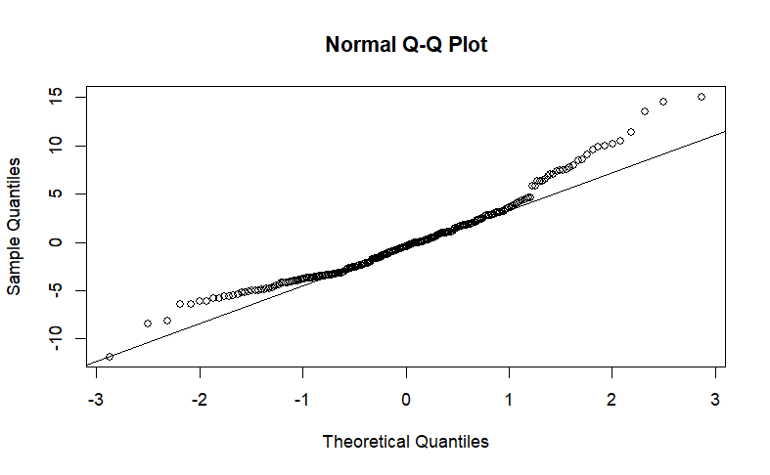
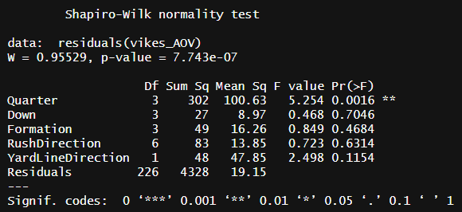
ANOVA

Slide 7
References
https://nflsavant.com/about.php
https://www.espn.com/nfl/team/schedule/_/name/min/minnesota-vikings
https://www.nytimes.com/interactive/2023/upshot/minnesota-vikings-nfl-playoff-picture.html
https://www.foxsports.com/articles/nfl/2023-nfl-offense-rankings-team-pass-and-rush-stats

